Slide 1

Yes we are
UNIVERSITY DEVELOPERS COMMUNITY
Like really...

Slide 2
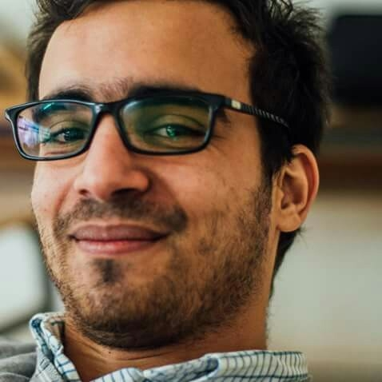
Yazid HANIFI ELHACHEMI AMAR
UDev founder & ex president
Pattern Recognition & Artificial Intelligence
Multi-platform Developer
Worked for ISSAL & dirassatic, unemployed
Reader, kind of poet, jazzy, blah blah

Slide 3
Who are we?
Who are we?
#1
To be or to be, for there is no escape
#1
To be or to be, for there is no escape

Slide 4
Who are we?
#1
To be or to be, for there is no escape
Scientists, Students, Technology enthousiasts
UDev = You Develop
UDev = University Developers Community
We are a meta University

Slide 5
Who are we?
#1
The big bang theory
February 3rd 2014
I had the Idea
February 6th 2014
First activity – A workshop
February 27th 2014
First Event – Welcome Day
Now
Still going

Slide 6
Our Vision
Our Vision
#2
Vision is the art of seeing what is invisible to others
#2
Vision is the art of seeing what is invisible to others

Slide 7
Our Vision
#2
Vision is the art of seeing what is invisible to others
Do it yourself
The world is bigger than University
But University must be a university
We want to create a student

Slide 8
Our Values
#3
Because we have a culture

Slide 9

Our Values
#3
Because we have a culture

Slide 10
Our Values
#3
Tesla > Edison
We try
We have no fear
We succeed
We fail
We survive to succeed again

Slide 11
Our History
Our History
#4
Because one year is more than enough
#4
Because two years are more than enough

Slide 12

Our History
#4
Teaching
Introduction a PHP
3 séances
Mr. Yazid HANIFI
Mr. Wail DJENANE
12 participants
05/02/2014

Slide 13

Our History
#4
Teaching
Atelier Linux-Ubuntu
Mr. Wail DJENANE
Mr. Hanifi Yazid
54 inscris
24 présents

Slide 14







Formations
2
Teaching
Atelier Linux-Ubuntu
Mr. Wail DJENANE
54 inscris
24 présents

Slide 15
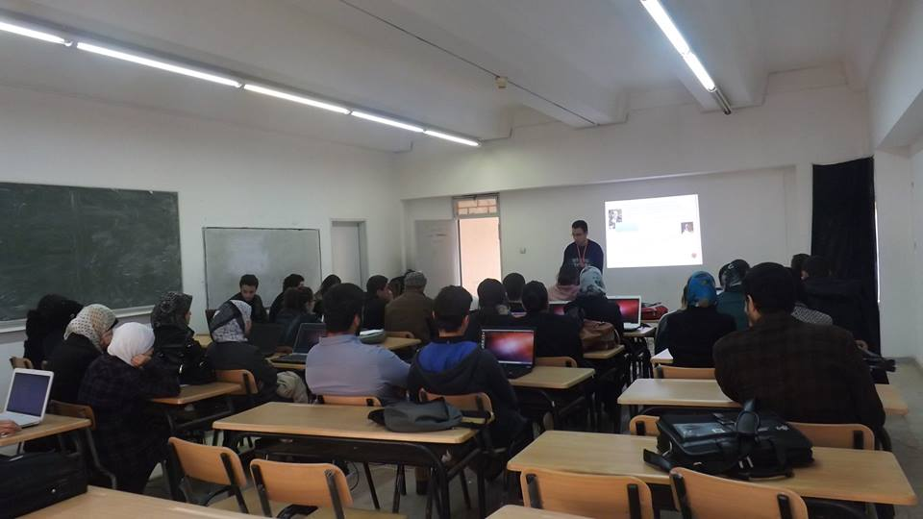
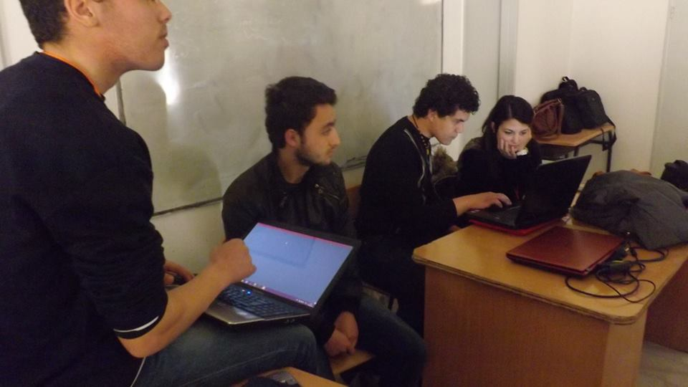
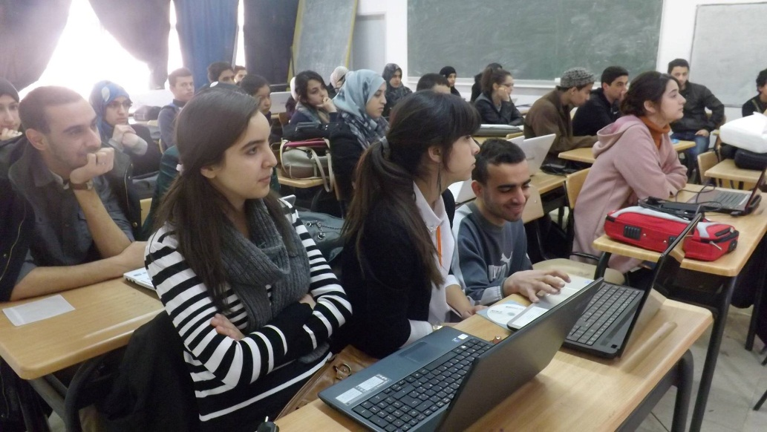
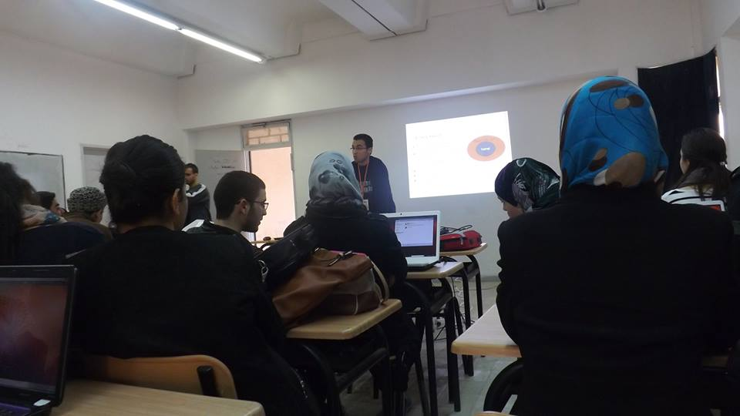
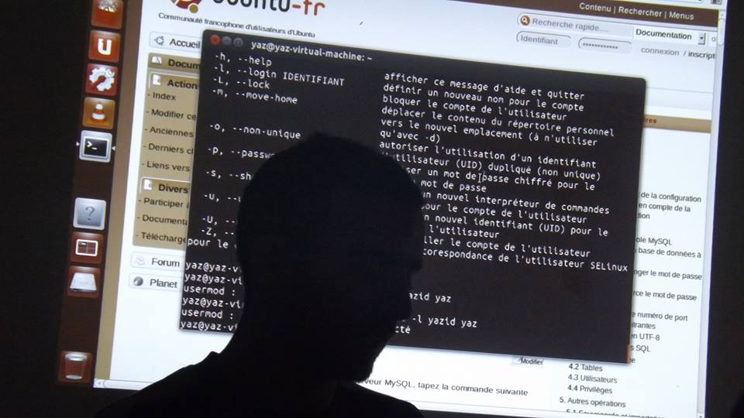
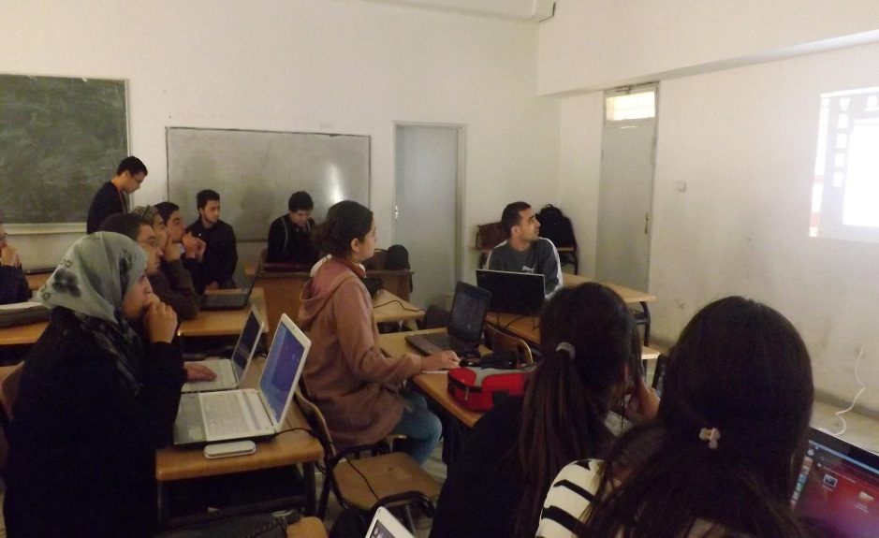
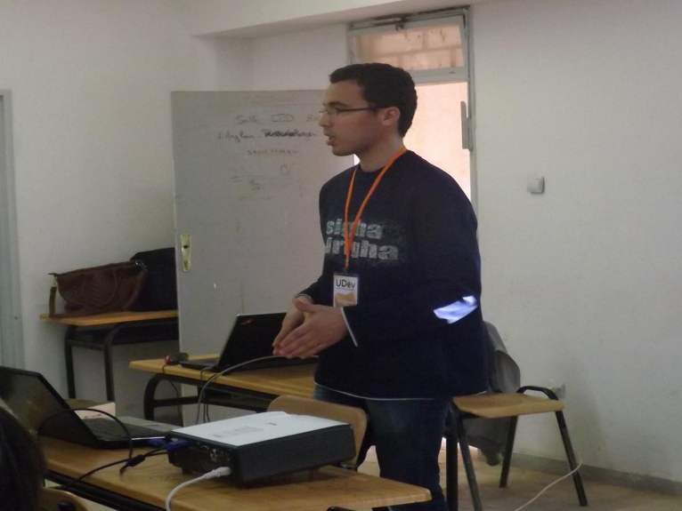
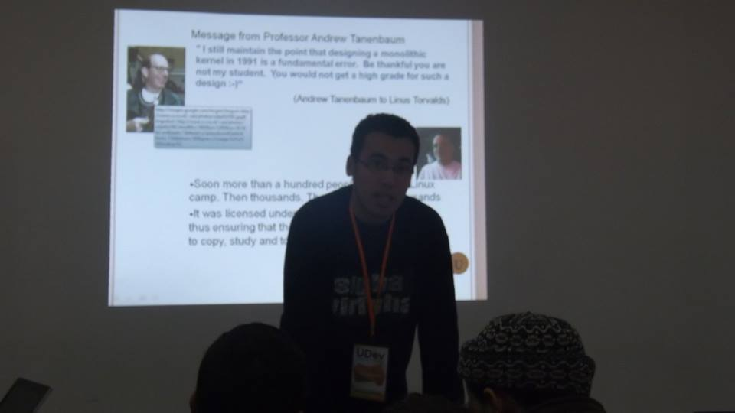

Slide 16

Formations
2
Teaching
Atelier Qt/C++: 3 séances
Mr. Walid ZEMALI
100 inscris
19 présents parmi 50 sélectionnés

Slide 17
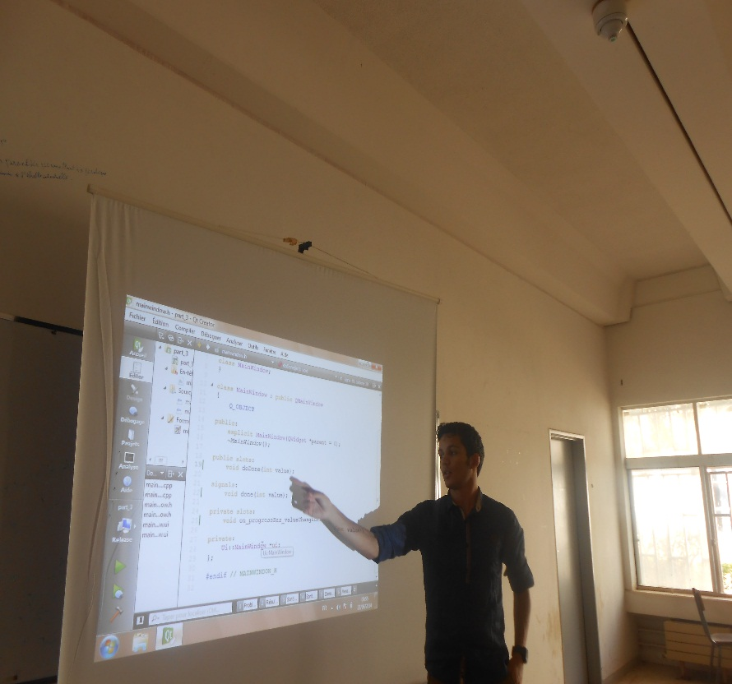
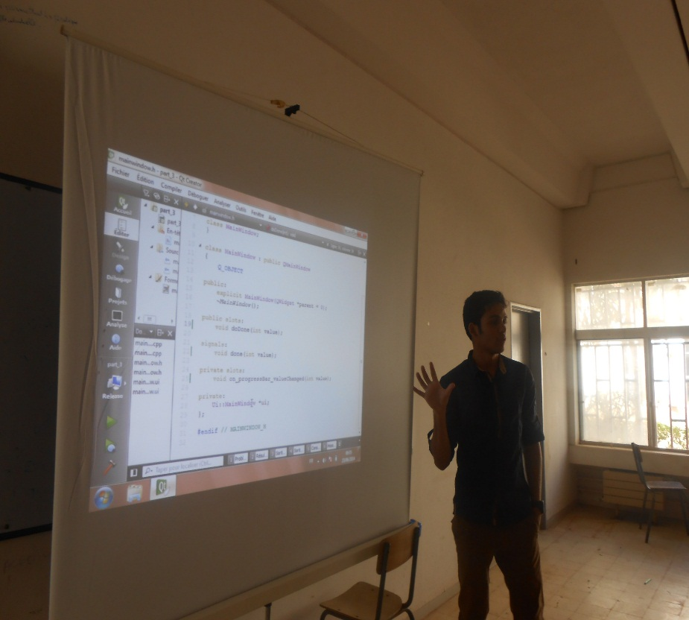
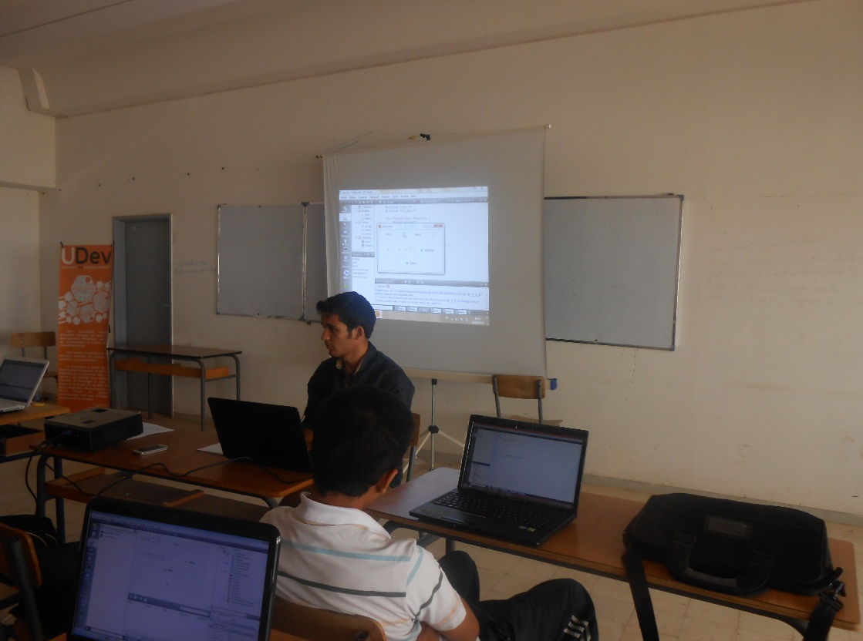
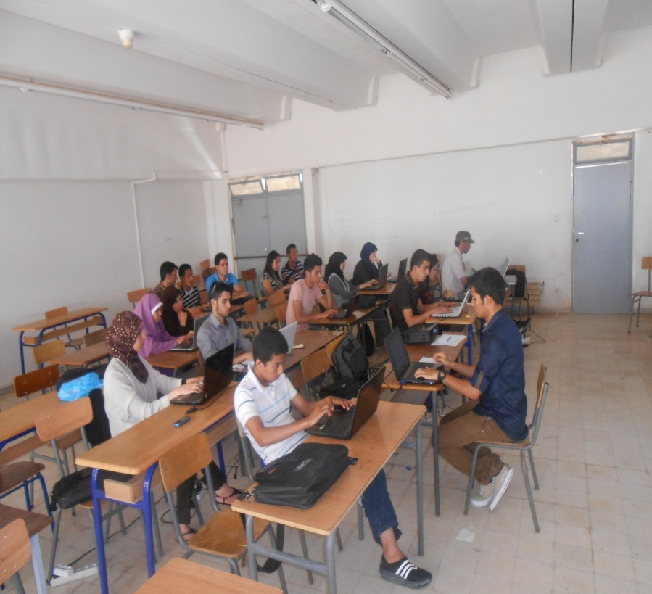
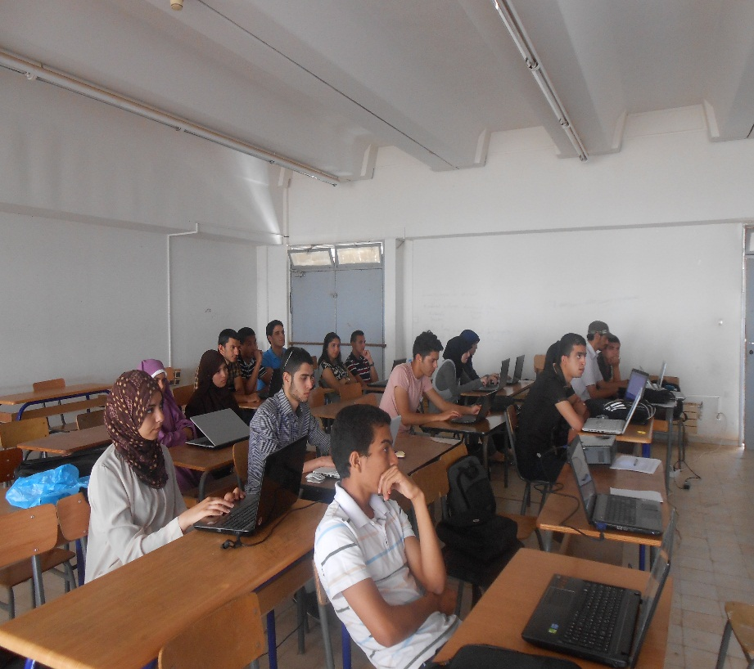
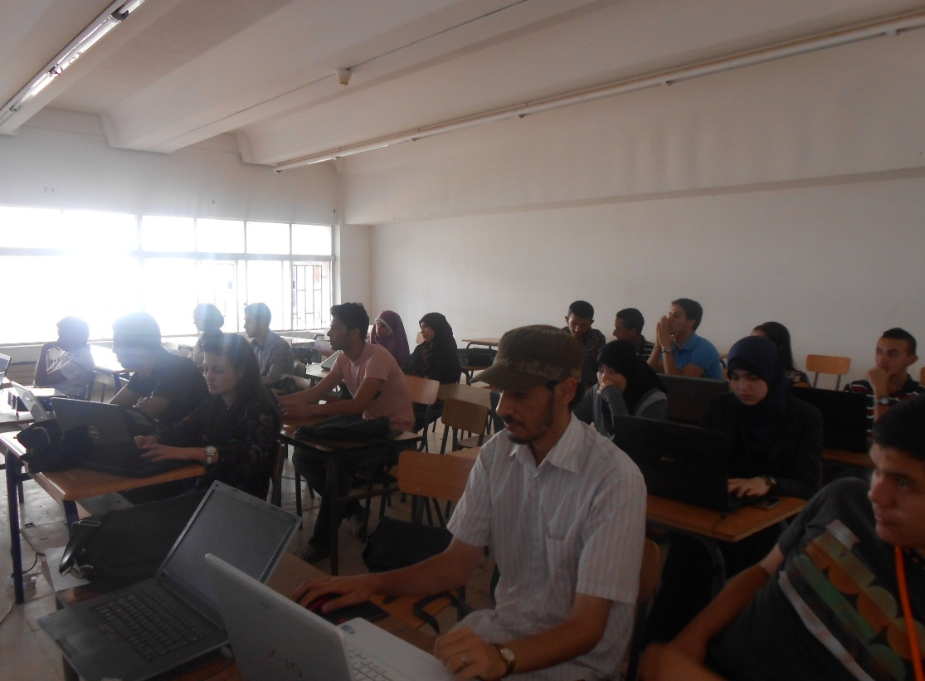

Slide 18

Formations
2
Teaching
Atelier Dev Web1 : 3 séances
Mr. Yazid HANIFI
105 inscris
31 présents parmi 50 sélectionnés.

Slide 19
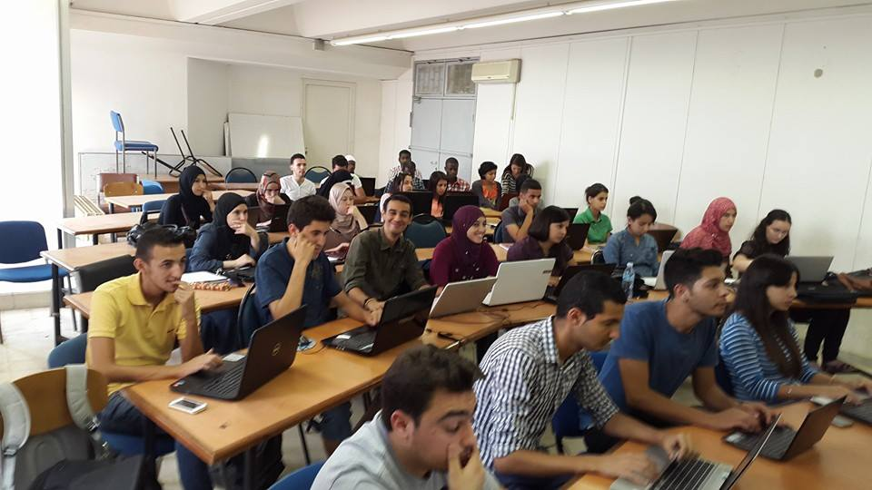
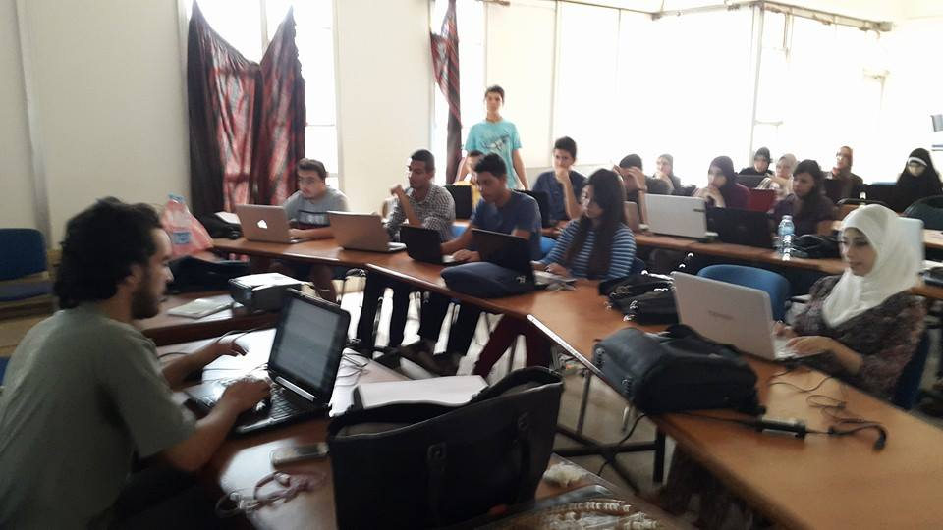
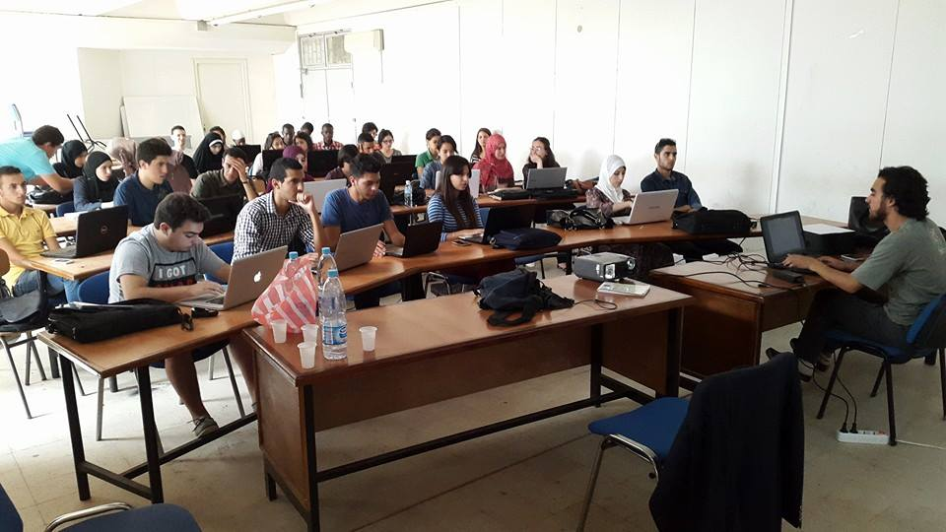
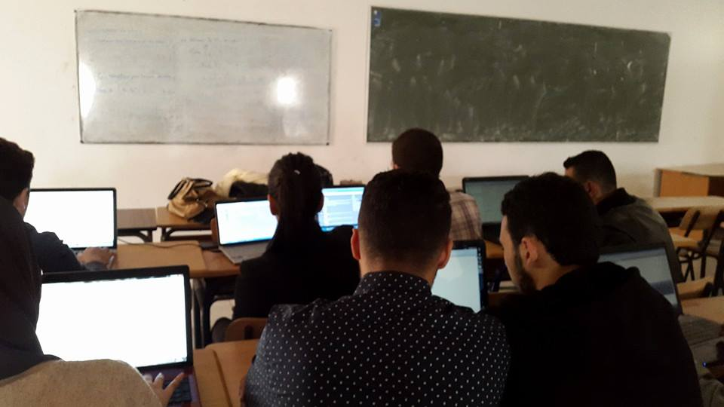
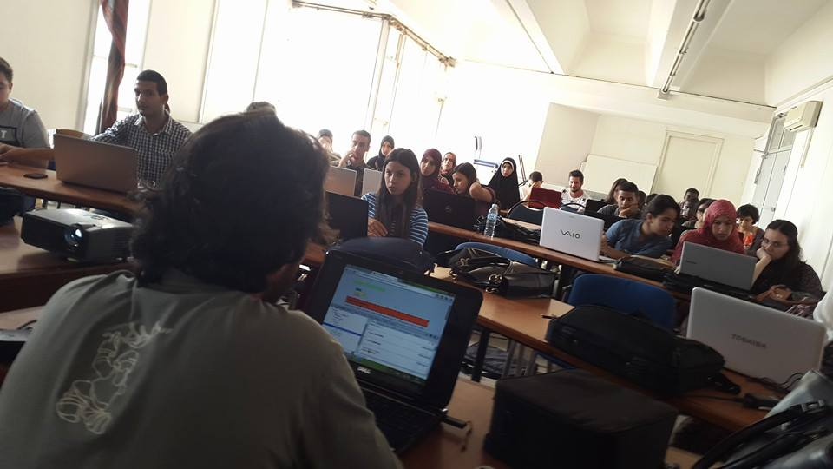
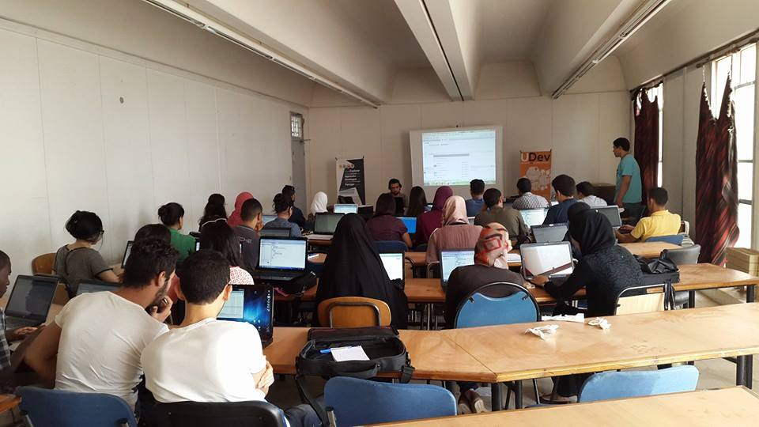

Slide 20
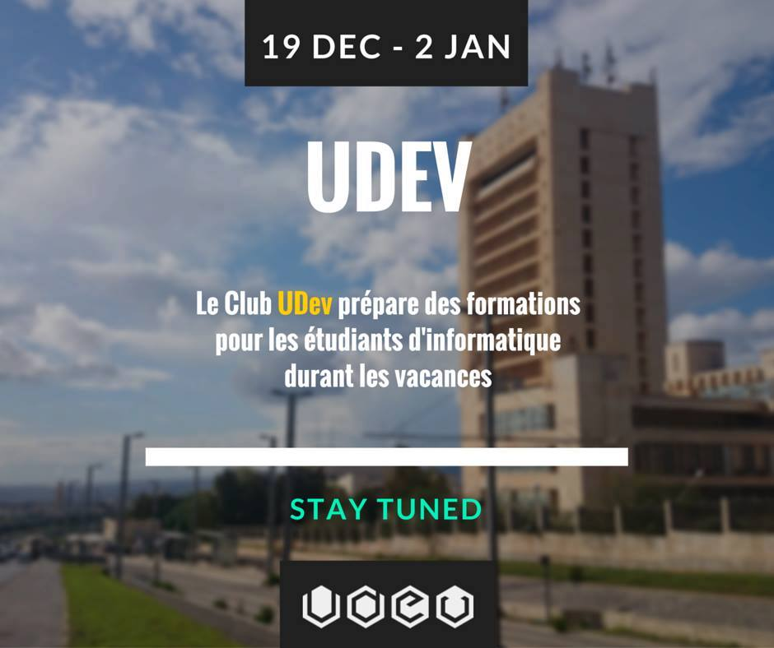
Formations
2
Teaching
Winter Break School : 2 formations en 3 jours
(1) Ruby on Rails : 3 séances
Mr. Omar Farouk MELIANI
43 inscris : 17 présents
1ére formation du genre gratuite en Algérie

Slide 21
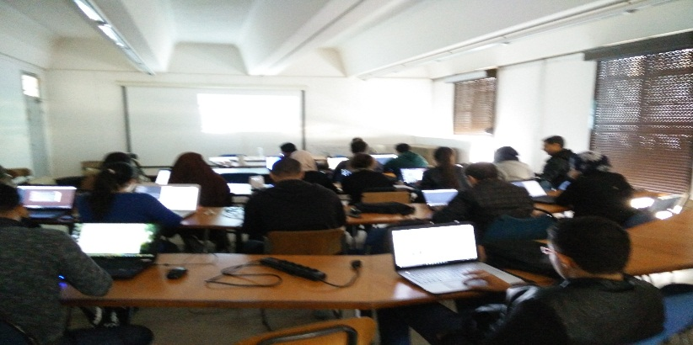
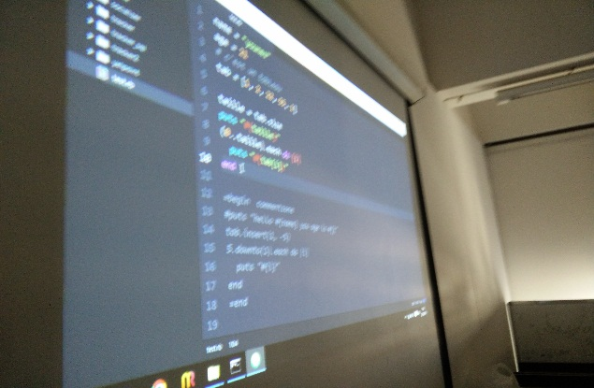
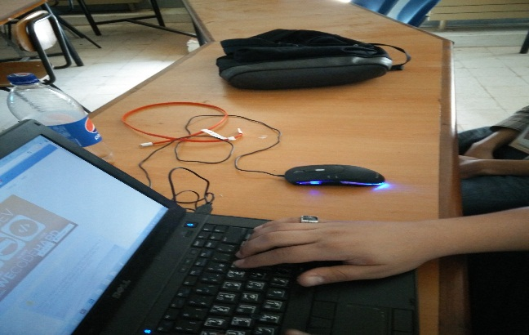
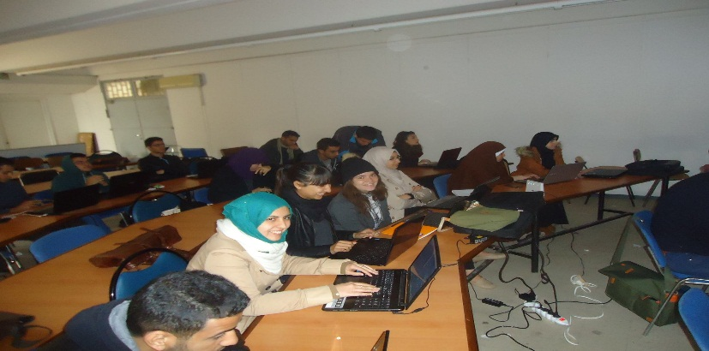
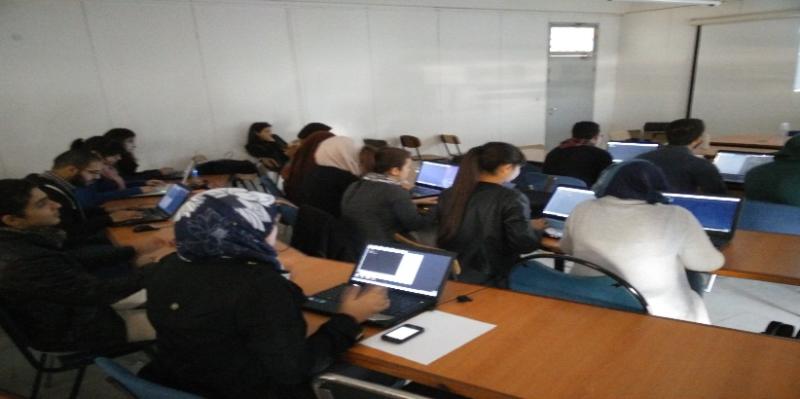
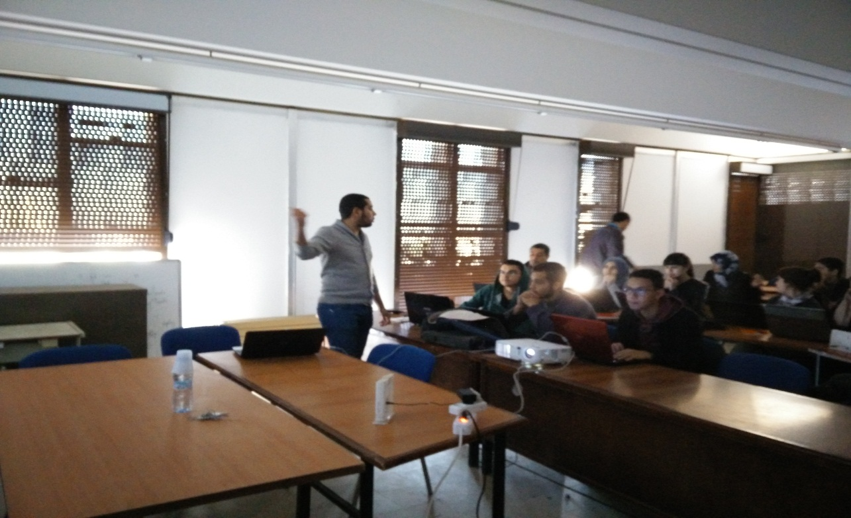
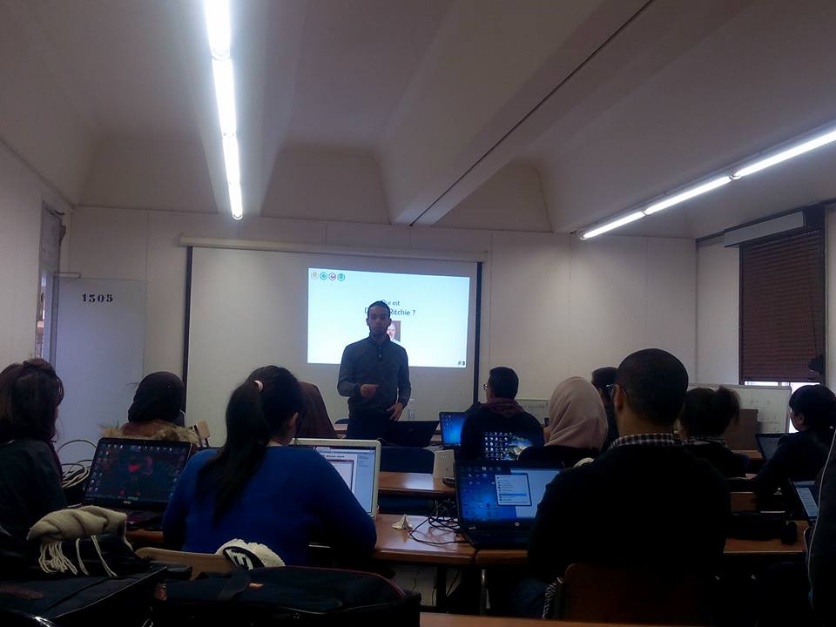
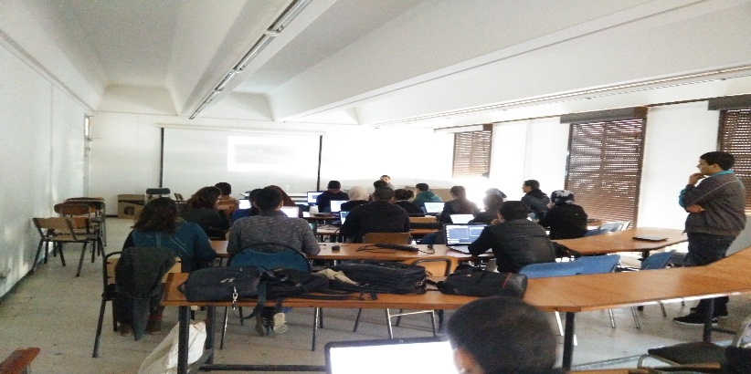
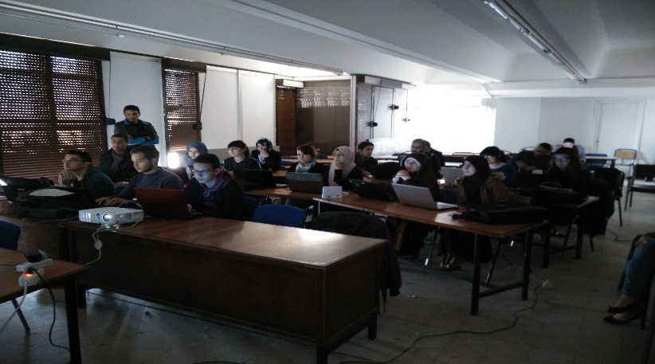
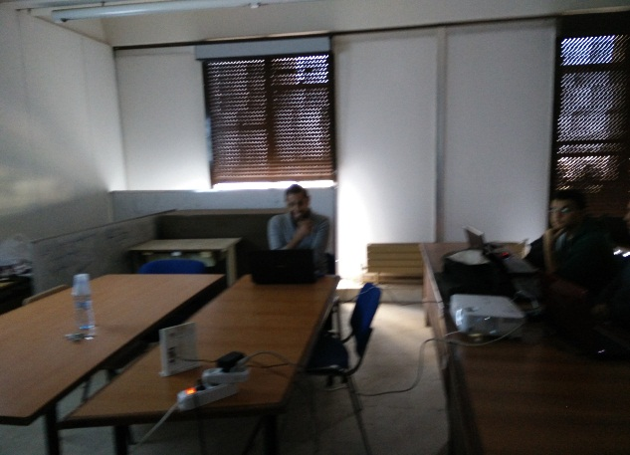
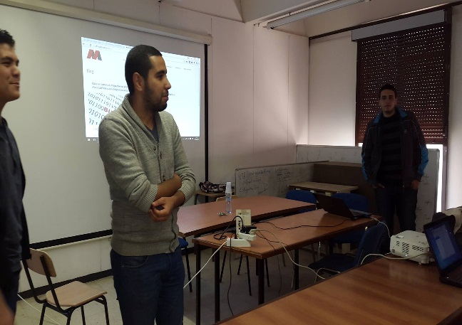
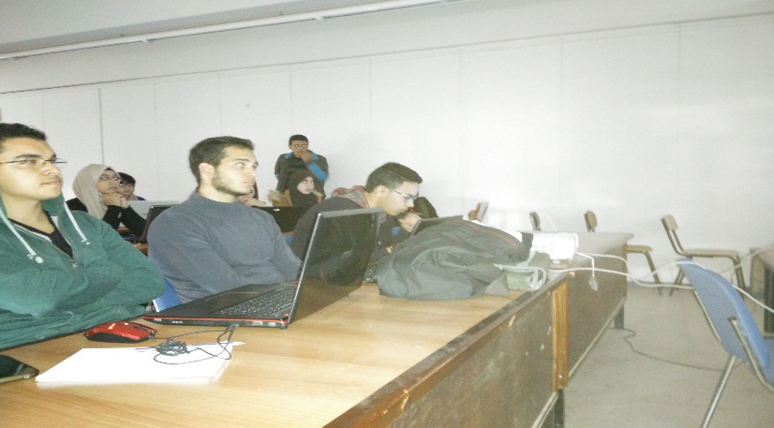

Slide 22
Formations
2
Teaching
Winter Break School : 2 formations en 3 jours
(2) Performance Tuning in MATLAB: 2 séances
Mr. Okba BEKHELIFI
32 inscris: 7 présents
1ére formation du genre
en Algérie

Slide 23
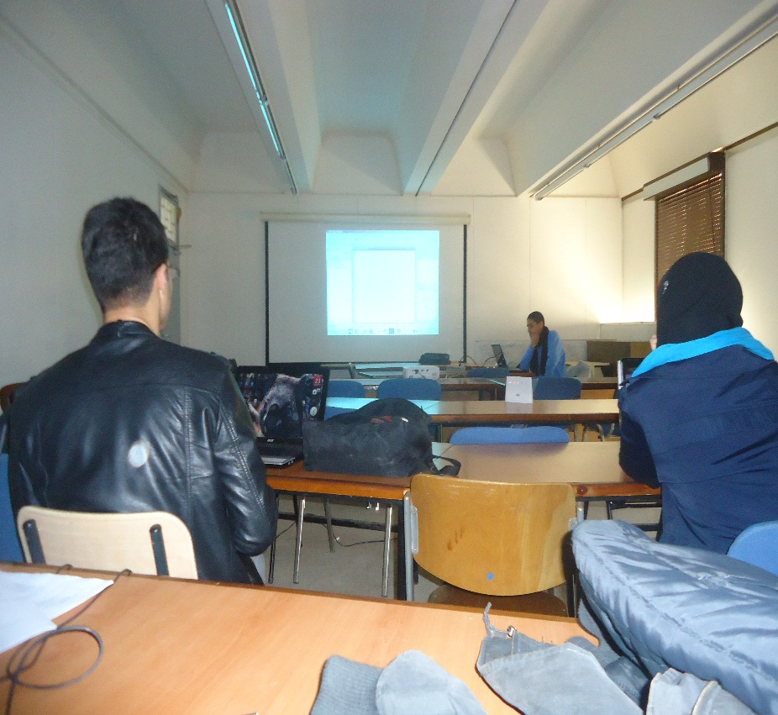
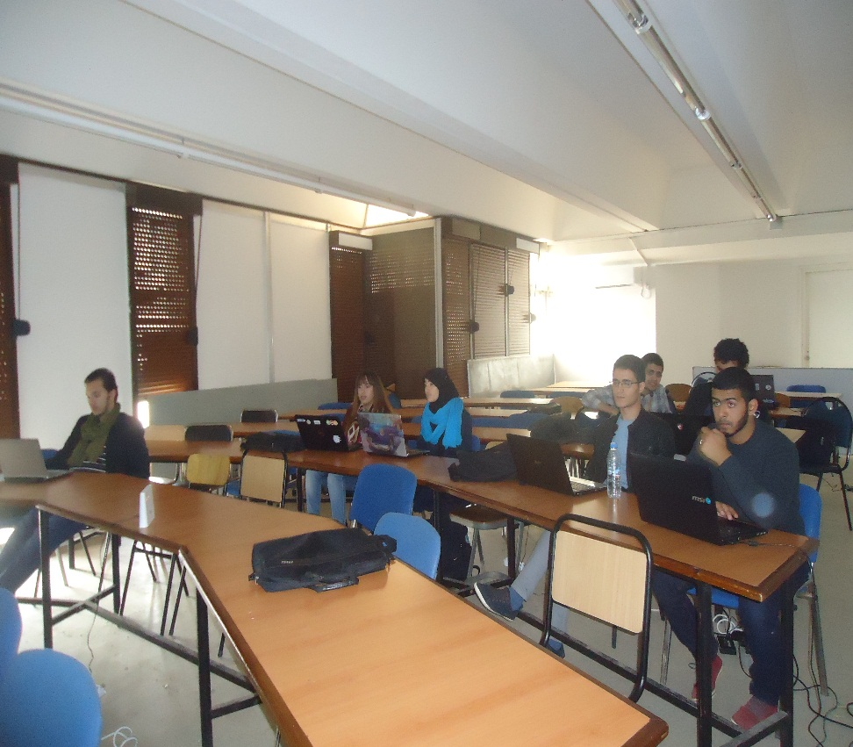
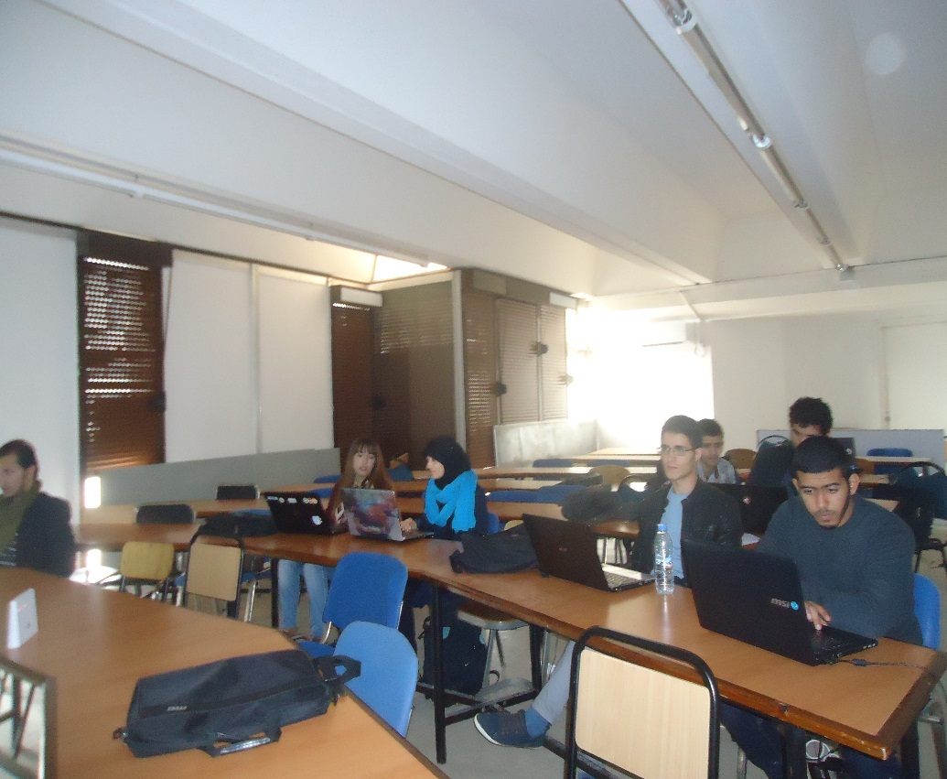
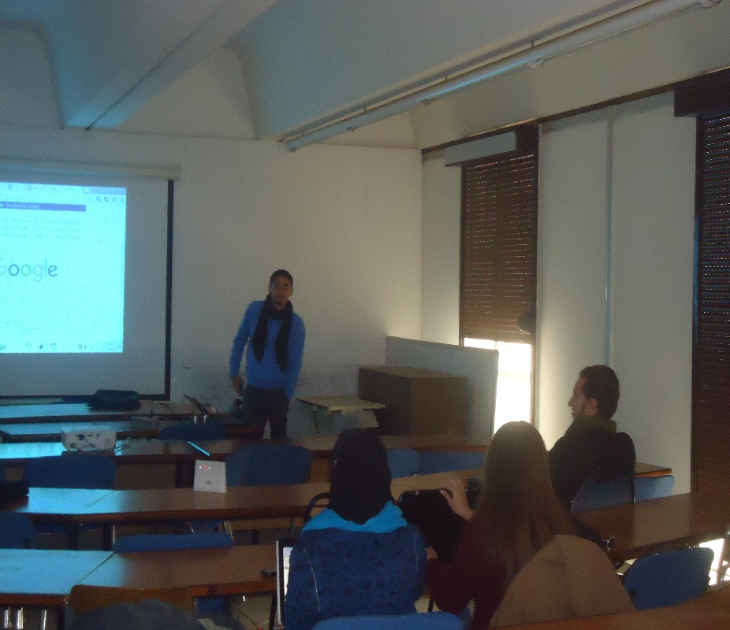
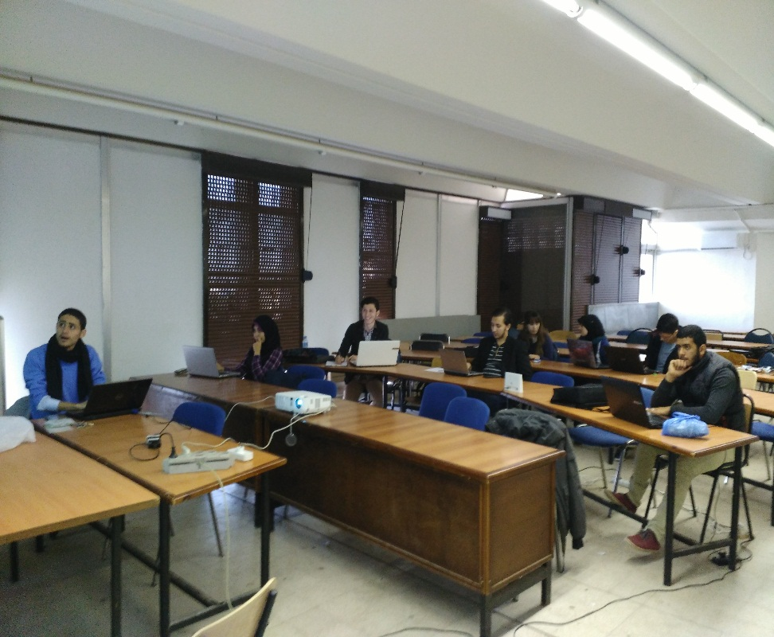
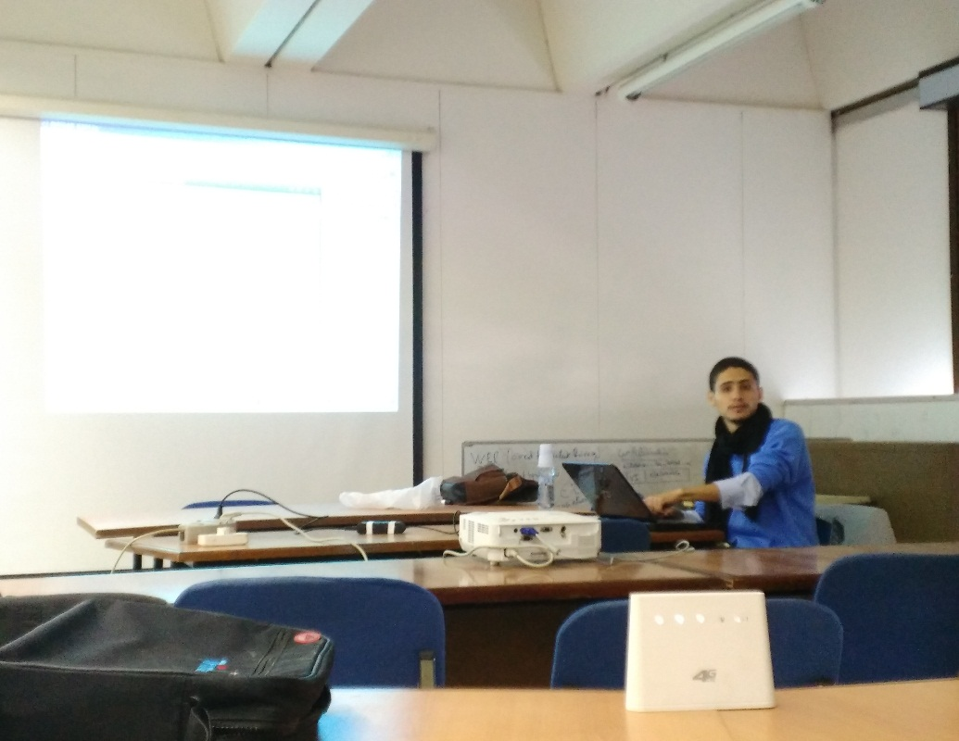

Slide 24








Formations
2
Teaching
« Formation spécial Club scientifique »
Community Management + Google Apps
Mr. Salim MAHBOUBI & Mr. Amine BENDAHMANE
Cible : Club INSEN (département de médicine)
30/12/2015, USTO-MB

Slide 25
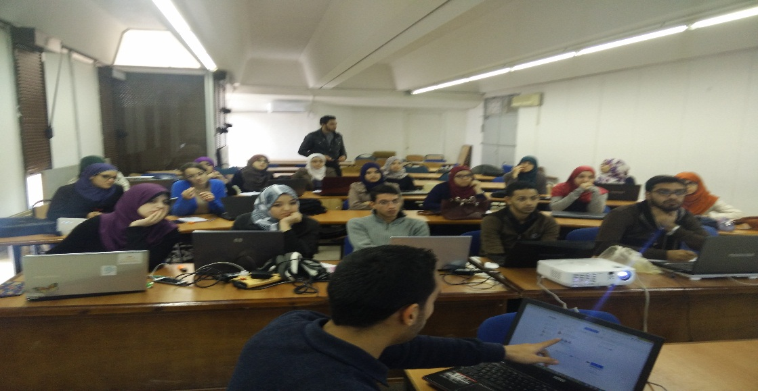
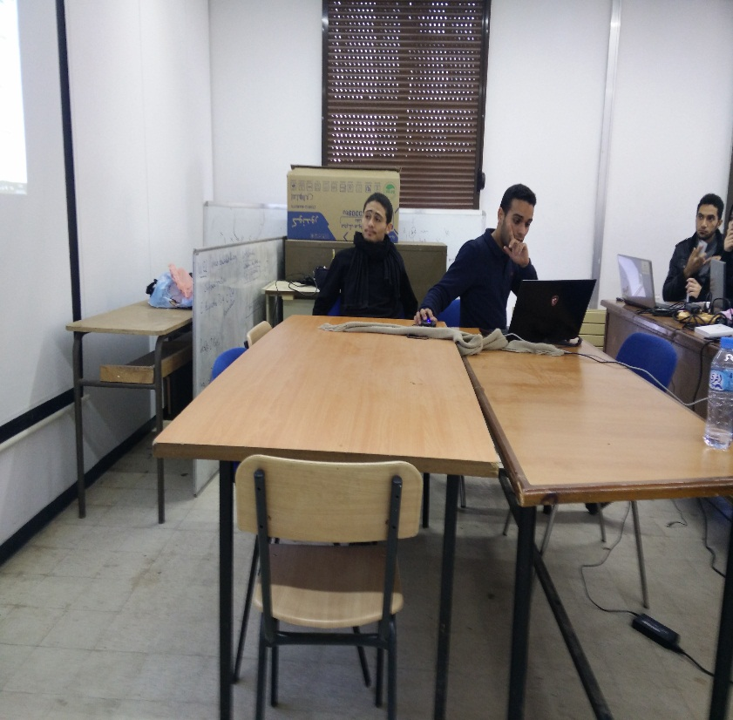
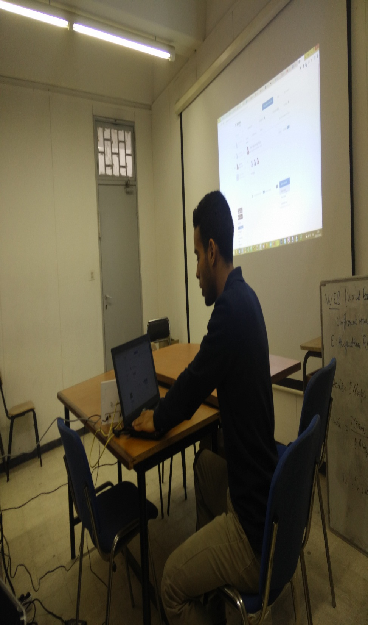
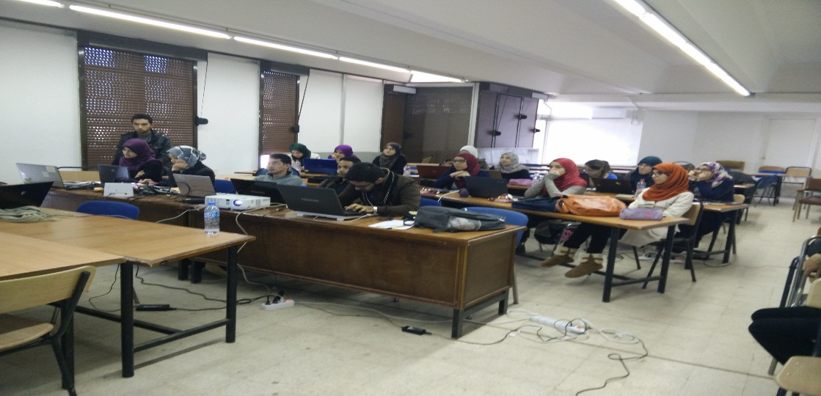
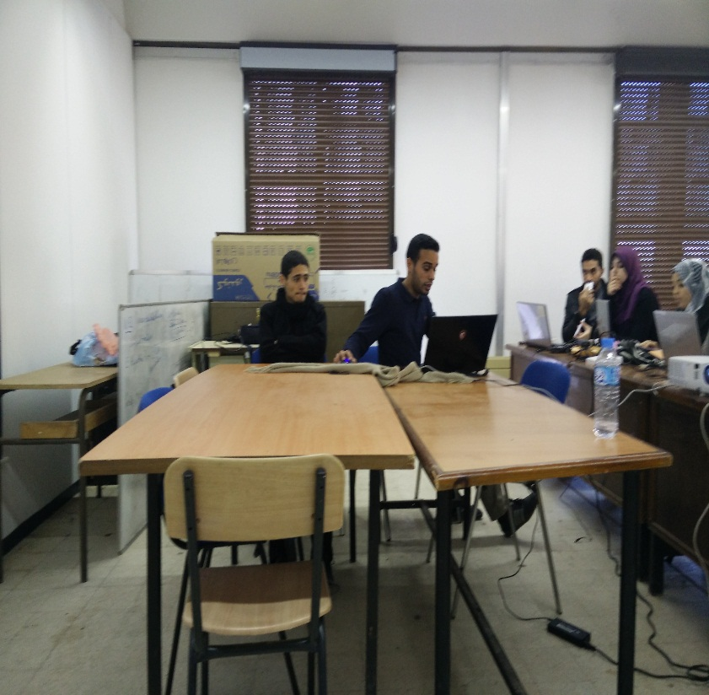
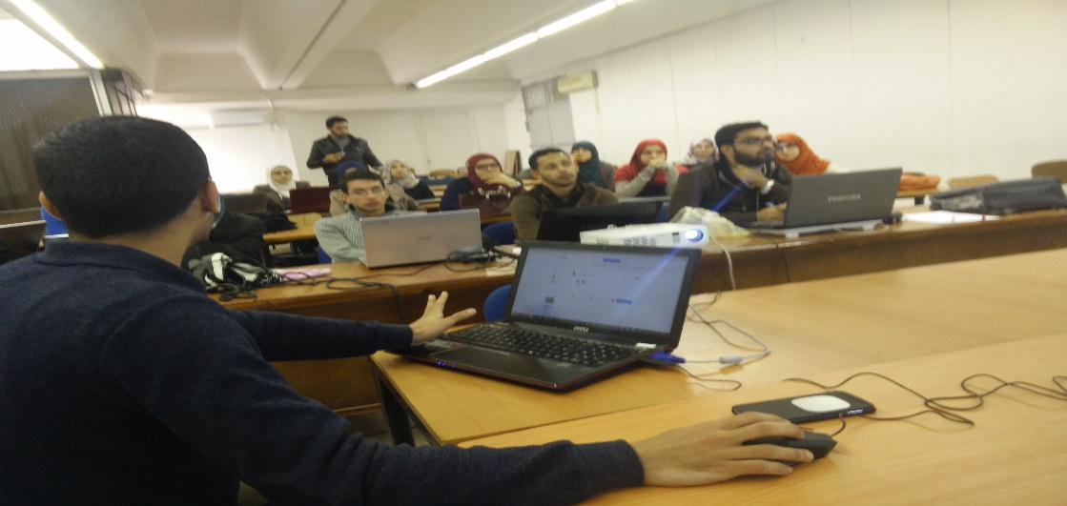

Slide 26
Formations
2
Teaching
« Formations spécial Club scientifique »
Community Management
Mr. Amine BENDAHMANE
Cible : Club Adjuvare (département de pharmacie)
31/12/2015, IGMO

Slide 27



3
Events
#USharing

Slide 28

Events
3
Sharing
Welcome Day: lancement du club
Présentation des formations de Master: RO, RFIA, TIC, INET, SIR, ISI, IVA
250+ présents

Slide 29
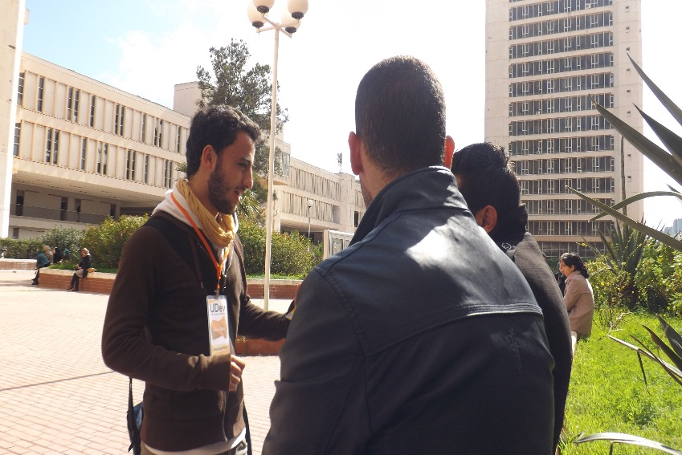
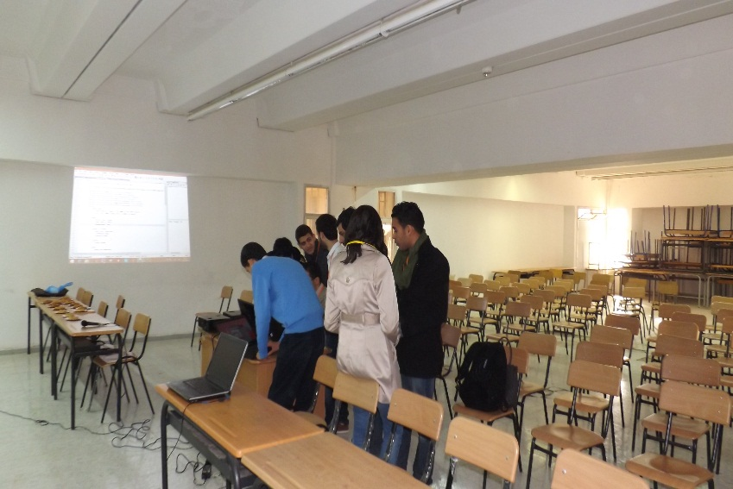
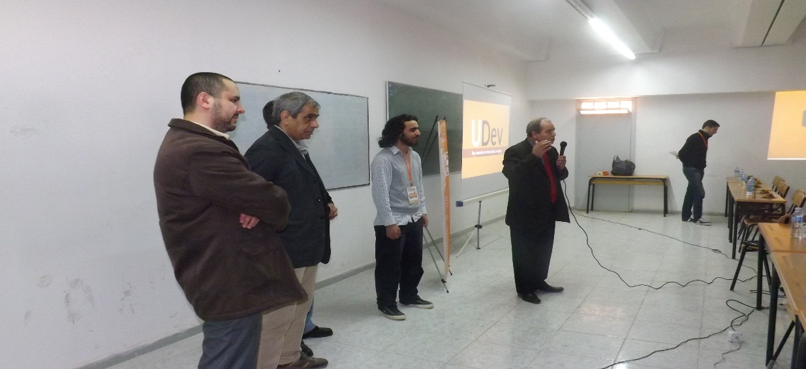
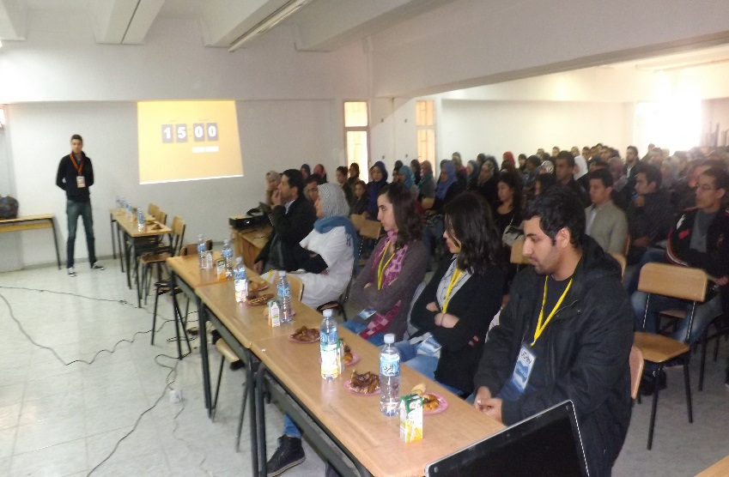






Slide 30







Slide 31

Events
3
Sharing
Open Day: Discover UDev
Outdoor event
Recrutement de nouveaux membres

Slide 32





Slide 33

Events
3
Sharing
Welcome Day 2: lancement des activités pour l’année universitaire 2014-2015
+100 présents
23/09/2014

Slide 34













Slide 35
5
Partenariat
#WeCollaborate

Slide 36

Partenariat
5
#WeCollaborate
« Formation »
Boot Camp iStart Obarmijoo en collaboration avec Ooredoo
Formation d'initiation au développement d'applications mobiles sur Android
Mr. Mohammed GUENDOUZ

Slide 37










Slide 38






Partenariat
5
#WeCollaborate
« Formation »
Photographie + Outil collaboratifs + Vidéographie
Mlle Rayhane BELAROUSSI, Mr. Amine BENDAHMANE & Mr. Oussama RAHOU
28/01/2016, USTO
UDev & INSEN

Slide 39








Slide 40

Partenariat
5
#WeCollaborate
With AMUN: UDev as IT Partner

Slide 41





Partenariat
5
#WeCollaborate
#Press : ALMAGNET

